Slide 1
Novel Computational Approaches to Investigate Microbial Diversity
Qingpeng Zhang
Department of Computer Science and Engineering
Michigan State University
Supervisor: Dr. Titus Brown

Slide 2
Outline
Background and motivation
An efficient k-mer counting approach
Novel method to investigate microbial diversity
Concept of IGS (informative genomic segment)
Testing IGS method on simulated data sets
Testing IGS method on real metagenome data
Summary

Slide 3
Outline
Background and motivation
An efficient k-mer counting approach
Novel method to investigate microbial diversity
Concept of IGS (informative genomic segment)
Testing IGS method on simulated data sets
Testing IGS method on real metagenome data
Summary
Background and motivation

Slide 4
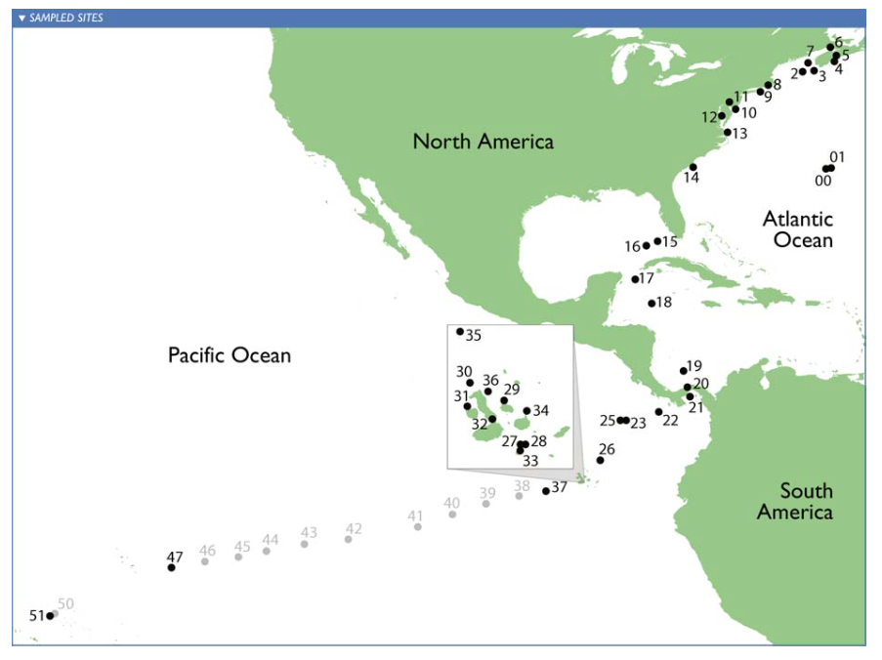
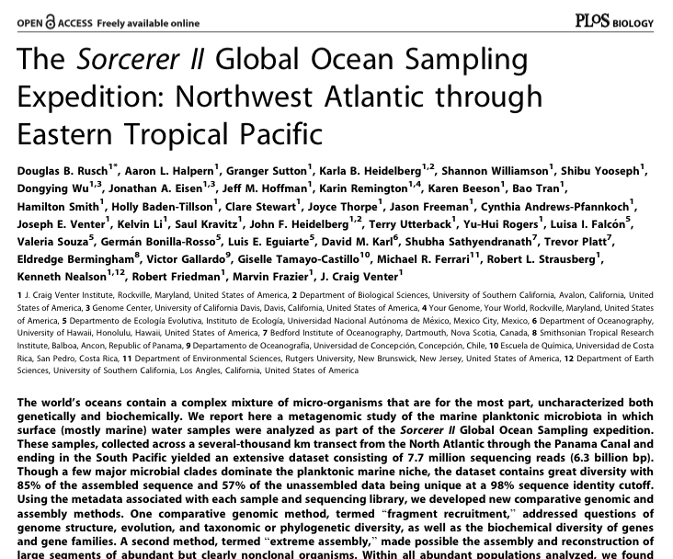
Sorcerer II Global Ocean Sampling Expedition
How many different species in a sea water sample? What is their abundance distribution? (alpha-diversity) [Hint: ~10,000 different types of microorganisms, 10 million viruses, one million bacteria in a drop.]
Are samples from tropical area and temperate area different?(beta-diversity) [Hint: Yes, but how different?]

Slide 5
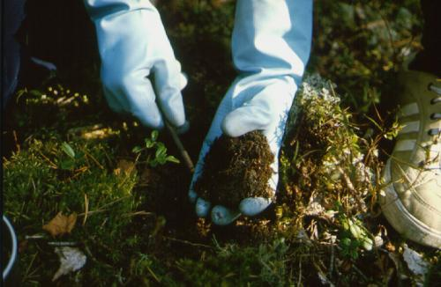
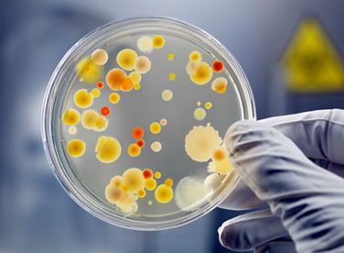
Metagenomics and
“big data”
”...functional analysis of the collective genomes of soil microflora, which we term the metagenome of the soil.”
- J. Handelsman et al., 1998
Most of the microorganisms can not be cultured and isolated and sequenced in traditional way.
10 million viruses, one million bacteria in a drop of seawater.
In a gram of soil, there are approximately a billion microbial cells, containing an estimated 4 petabase pairs of DNA (Jack A. Gilbert,2013)
+
Improvement of next generation sequencing = data deluge
+
Decreasing cost of sequencing
Notes:
Metagenomics,

Slide 6

Metagenomics and
“big data”
”...functional analysis of the collective genomes of soil microflora, which we term the metagenome of the soil.”
- J. Handelsman et al., 1998
most of the microorganisms can not be cultured and isolated and sequenced in traditional way.
In a gram of soil, there are approximately a billion microbial cells, containing an estimated 4 petabase pairs of DNA (Jack A. Gilbert,2013)
+
Improvement of next generation sequencing = data deluge
+
Decreasing cost of sequencing

Slide 7
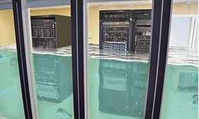
Metagenomics and
“big data”
”...functional analysis of the collective genomes of soil microflora, which we term the metagenome of the soil.”
- J. Handelsman et al., 1998
most of the microorganisms can not be cultured and isolated and sequenced in traditional way.
In a gram of soil, there are approximately a billion microbial cells, containing an estimated 4 petabase pairs of DNA (Jack A. Gilbert,2013)
+
Improvement of next generation sequencing = data deluge
+
Decreasing cost of sequencing
http://www.e-janco.com/

Slide 8
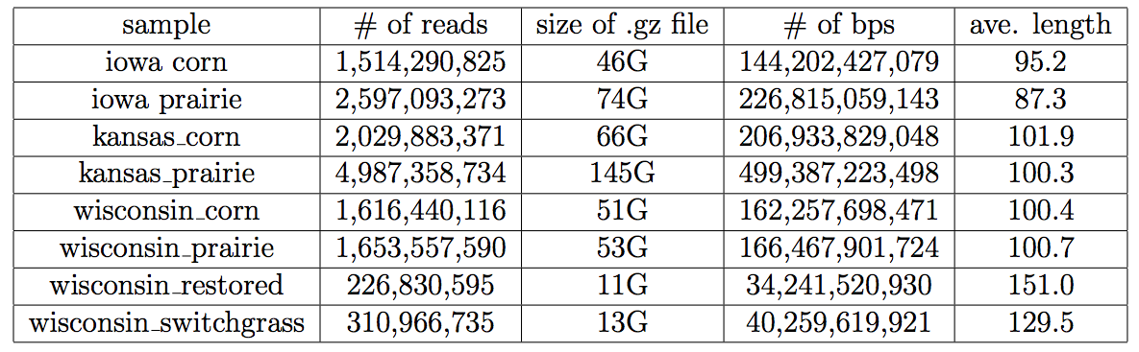
Metagenomics and
“big data”
Bacterial genome size: 139,000 bps to 13,000,000 bps
Human genome size: 3,000,000,000 bps
Notes:
Big data requires scalable approaches.

Slide 9
Sorcerer II Global Ocean Sampling Expedition
How many different species in a sea water sample? What is their abundance distribution? (alpha-diversity) [Hint: ~10,000 different types of microorganisms, 10 million viruses, one million bacteria in a drop.]
Are samples from tropical area and temperate area different?(beta-diversity) [Hint: Yes, but how different?]
Notes:
Go back to diversity questions.

Slide 10
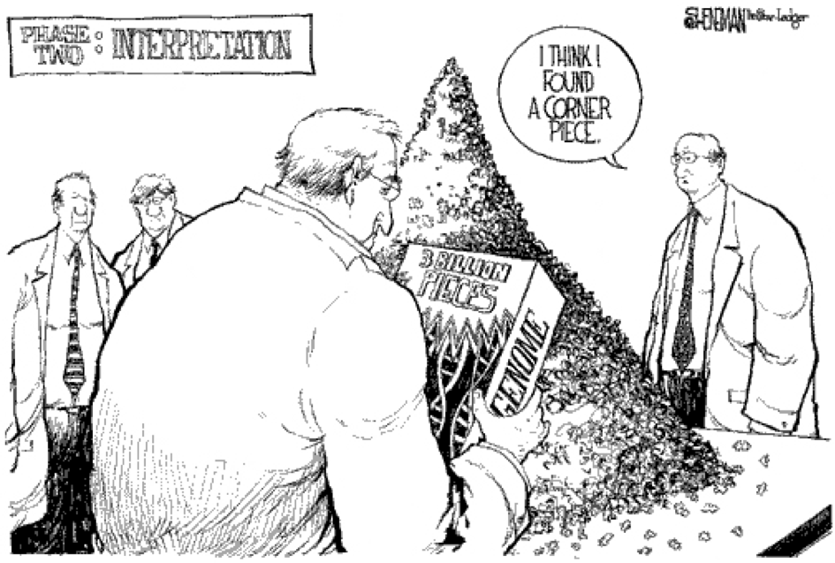
Genome and Book

Slide 11

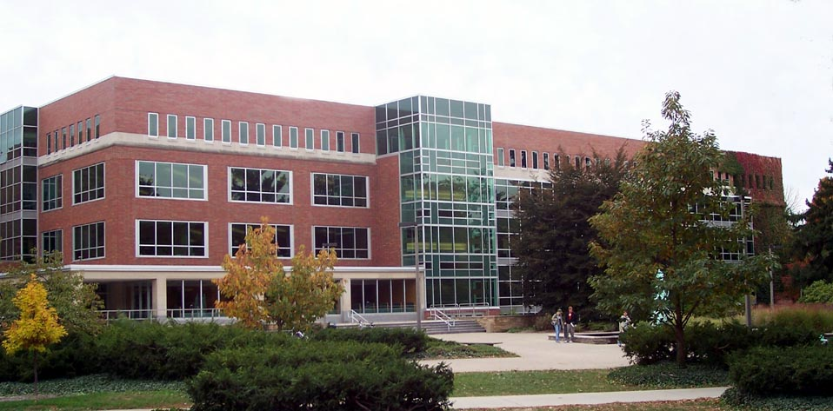

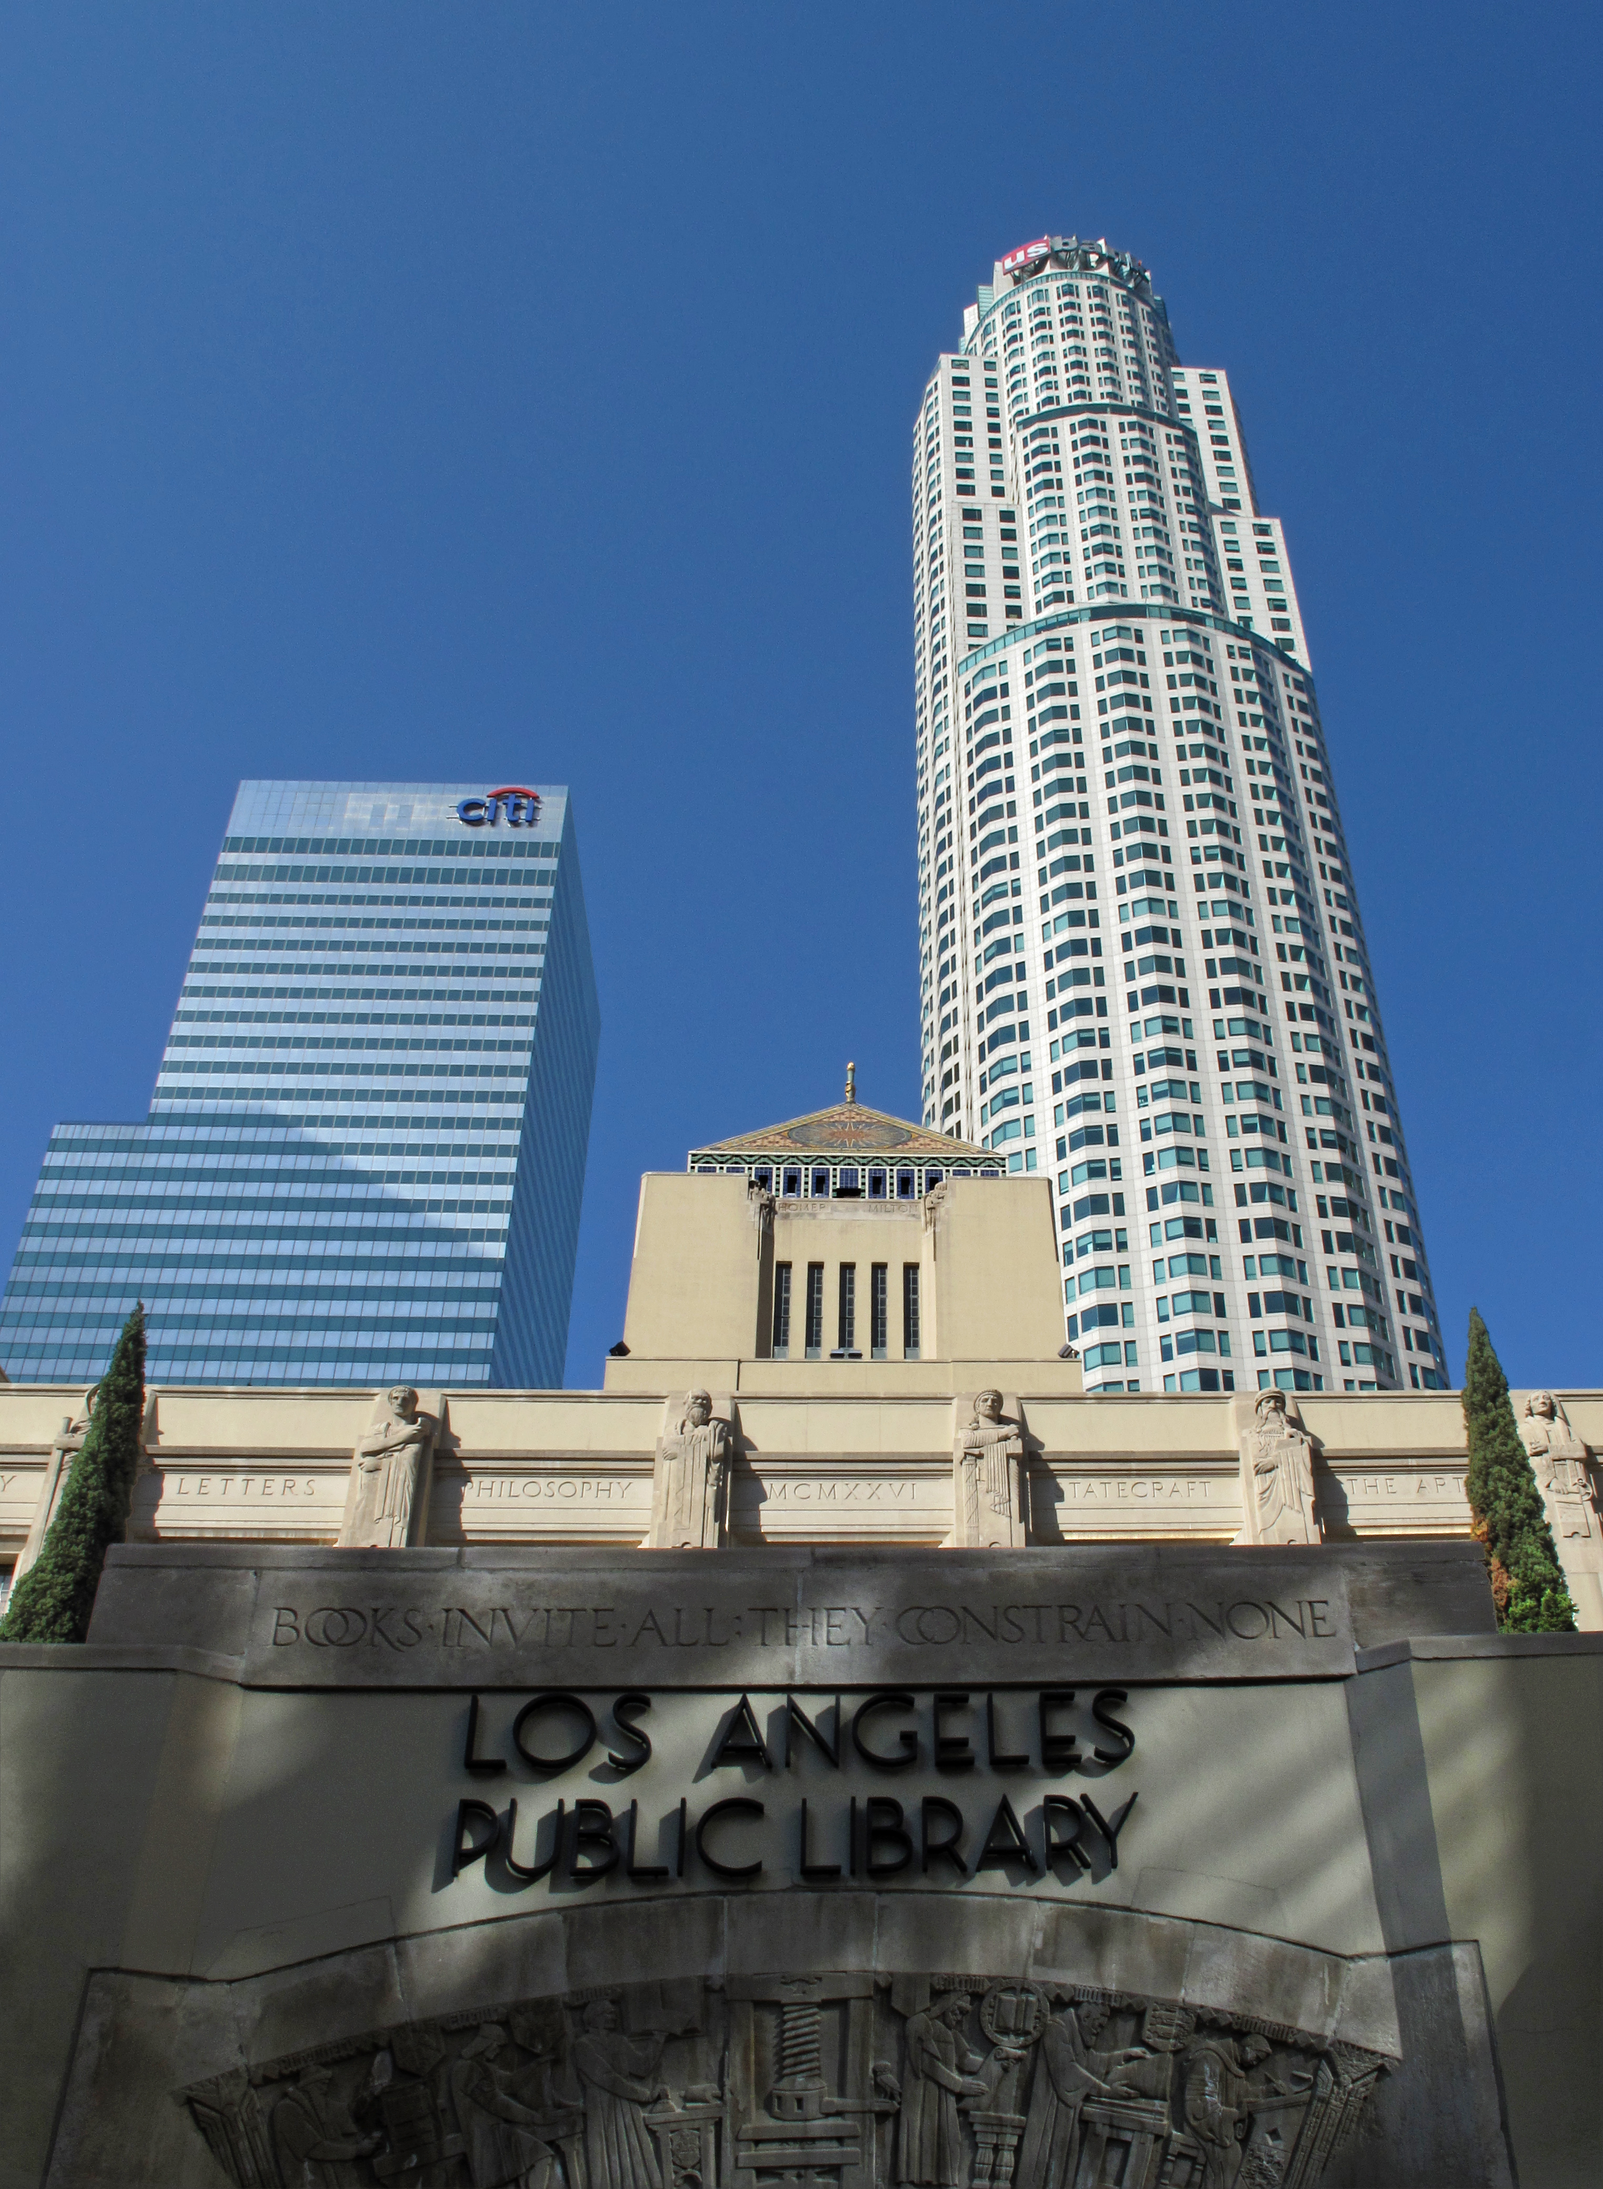

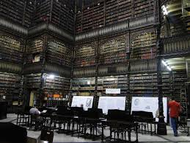


Notes:
Analogy to library – books – shredded sentences

Slide 12
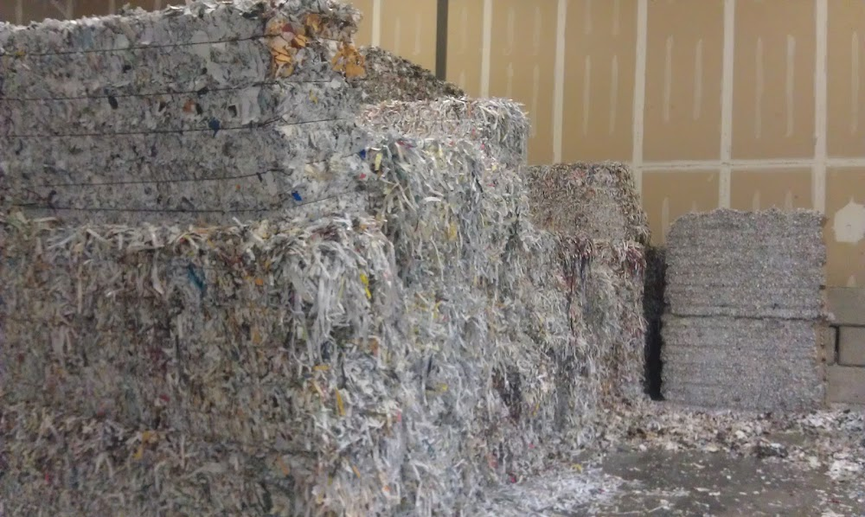
Which library has more titles?
With only shredded pieces of pages with (partial) sentences on it to read.

Slide 13
How similar are the libraries by their collection?
With only shredded pieces of pages with (partial) sentences on it to read.

Slide 14
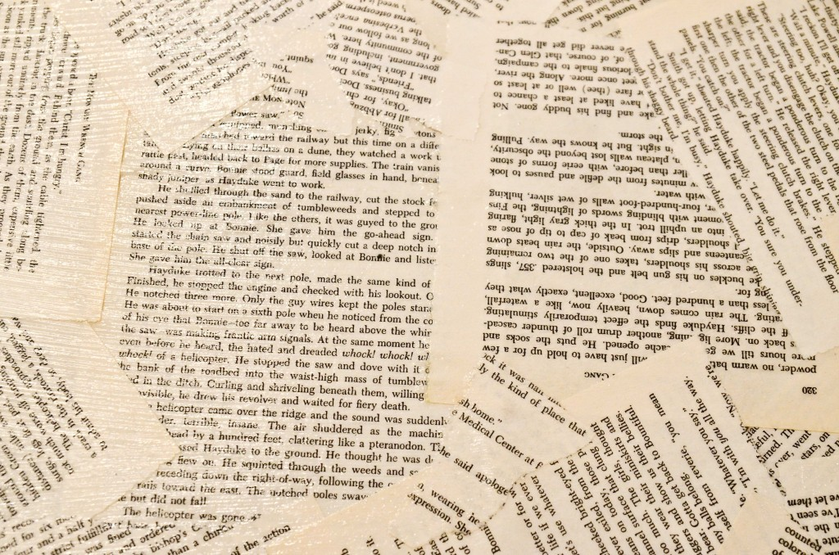

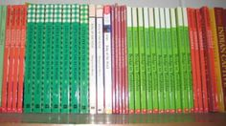
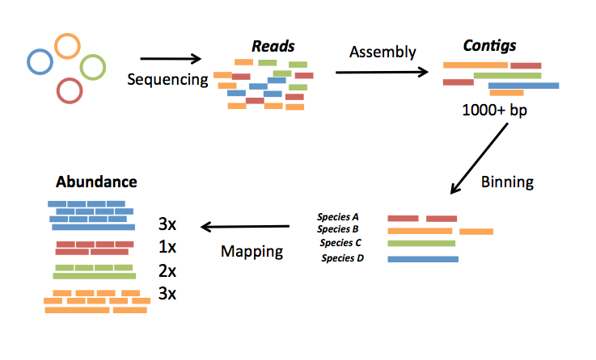
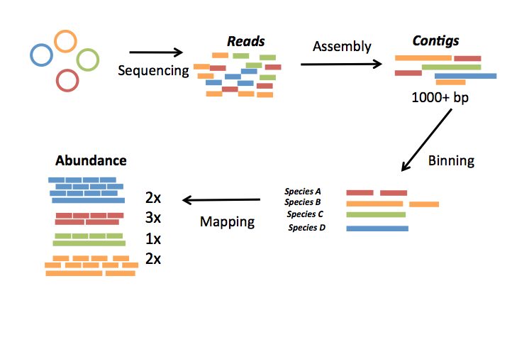
A typical pipeline of metagenome diversity analysis
Sample1
Reads
Assembly
Contigs
Sequencing
1000+ bp
100-150 bp
Abundance
Species
Binning
3x
1x
1x
2x
Species A
Species B
Mapping
Species C
Species D
 | Sample1 | Sample2 | Sample3 | Sample4 | Sample5
Species A | 3 | 3 | 4 | 4 | 0
Species B | 1 | 3 | 0 | 2 | 2
Species C | 1 | 2 | 2 | 2 | 3
Species D | 2 | 1 | 2 | 1 | 1
Sample5
Sample4
Sample3
Sample2
Loosely based on slide by Mads Albertsen
Notes:
Ok to answer the diversity question like how different two soil samples are. Here I will introduce a typical p l of m d analysis.
Firstly. We do sequencign, got reads, then do assemlby, longer, do bining, classify into species, or unit, then map reads back to species, contigs, to get the abundance , do this to every sampke, we get a table with the abundance of species, across sample,s whichi fotern claled samples by species matrix.

Slide 15
 | Sample1 | Sample2 | Sample3 | Sample4 | Sample5 | Sample6
SpeciesA | 3 | 3 | 4 | 4 | 0 | 0
SpeciesB | 1 | 3 | 0 | 2 | 2 | 2
SpeciesC | 1 | 2 | 2 | 2 | 3 | 3
SpeciesD | 2 | 1 | 2 | 1 | 1 | 1
SpeciesE | 4 | 1 | 3 | 0 | 2 | 5
SpeciesF | 5 | 1 | 2 | 2 | 2 | 5
SpeciesG | 2 | 2 | 1 | 2 | 1 | 3
 | S1 | S2 | S3 | S4 | S5 | S6
S1 | 0.0 | 0.25 | 0.5 | 0.5 | 0.75 | 1.0
S2 | 0.25 | 0.0 | 0.25 | 0.25 | 0.75 | 1.0
S3 | 0.5 | 0.25 | 0.0 | 0.25 | 0.75 | 1.0
S4 | 0.5 | 0.25 | 0.25 | 0.0 | 0.75 | 1.0
S5 | 0.75 | 0.75 | 0.75 | 0.75 | 0.0 | 0.25
S6 | 1.0 | 1.0 | 1.0 | 1.0 | 0.25 | 0.0
Alpha diversity: “How many different species in a seawater sample?”
Beta diversity: “How different are the seawater samples?”
Notes:
With this samples by species matrix, we can get similarity matrix between samples and do alpha diversity analysis or beta divesity to compare samples.

Slide 16
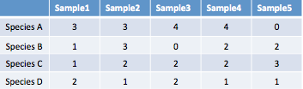
A typical pipeline of metagenome diversity analysis
Sample1
Reads
Assembly
Contigs
Sequencing
1000+ bp
100-150 bp
Abundance
Species
Binning
3x
1x
1x
2x
Species A
Species B
Mapping
Species C
Species D
Samples by species table
Challenges:
Assembly? - difficult (Only small portions of reads can be assembled, low sequencing depth, high diversity sample)
Loosely based on slide by Mads Albertsen
Notes:
Ok ti loks streagith forwad, but if we revisit the pipeline, or run the pipleine actuall,ly, we know not so easy, facing chanllge
Firstlyl, assbmly is difficlulty ,. Oly small, can be assembled,
Yes. We can .
What is IGSs.
Igs represent the novel information in a sample.

Slide 17
A typical pipeline of metagenome diversity analysis
Sample1
Reads
Assembly
Contigs
Sequencing
1000+ bp
100-150 bp
Abundance
Species
Binning
3x
1x
1x
2x
Species A
Species B
Mapping
Species C
Species D
Samples by species table
Challenges:
Binning? – difficult (may need reference genomes, computationally expensive, definition of “species” is ambiguous in microbial world. )
Loosely based on slide by Mads Albertsen
Notes:
Next step binning, is not better, also difficulty, two methods similarity based, and composition based, need reference , computa expensive.
Can we do diversity analysis , get the species by sample table without need for assembly, binning, mapping??
Assembly,binning, mapping, are important, for function. Phylogentic , for now for the purpose of diversity analysis, compare etagen samples, can we avoid them? And do directly??
Wht we need to do is replace…
Yes. We can .
What is IGSs.
Igs represent the novel information in a sample.

Slide 18
A typical pipeline of metagenome diversity analysis
Sample1
Reads
Assembly
Contigs
Sequencing
1000+ bp
100-150 bp
Abundance
Species
Binning
3x
1x
1x
2x
Species A
Species B
Mapping
Species C
Species D
Samples by species table
Challenges:
Mapping? – difficult (low accuracy because of sequencing error, computationally expensive)
Loosely based on slide by Mads Albertsen
Notes:
Mapping,normally is computationally expensive, we are taling about
Yes. We can .
What is IGSs.
Igs represent the novel information in a sample.

Slide 19
A typical pipeline of metagenome diversity analysis
Sample1
Reads
Assembly
Contigs
Sequencing
1000+ bp
100-150 bp
Abundance
Species
Binning
3x
1x
1x
2x
Species A
Species B
Mapping
Species C
Species D
Samples by species table
Challenges:
Assembly? - difficult (eg. Only small portions of reads can be assembled)
Binning? – difficult (eg. may need reference genomes, computationally expensive)
Mapping? – difficult (eg. accuracy, computationally expensive)
4 petabase pairs of DNA in a gram of soil(Jack A. Gilbert,2013)
Notes:
Mapping,normally is computationally expensive, we are taling about
Don’t forget the scary number of 4 pteabased. Trribase sequencign, dataset, painful to do mapping , blaoor bowtie.
So the wuqesiton is can we find a shortcut, to do diversity anslyiss, alike get the clustering, without ….
The answer is yes we can.
Althought,
Assembly,binning, mapping, are important, for function. Phylogentic , for now for the purpose of diversity analysis, compare etagen samples, it is possible to avoid the process.
What we will do is to get replacie the sampels by species table by ssample sby other unit.

Slide 20
Reads – sample A
Reads -> k-mers
>24288227
TTTGCCTGTTGAAAACCTGAAAACGGGATGTTTCCGGGGTTTTCCGCCCCGGTAGGGTTGAGACGTGCCCCGCGGTCGCGAACAGCTCGCCGCTTACCGGCGTAAGAGCGATCCGCAACACACCCCGGAGCCTCTACCCCCCCCTCACGC
Reads – sample B

Slide 21
Counting (unique) k-mers to evaluate diversity
Reads – sample A
K-mers – sample A
Reads – sample B
K-mers – sample B

Slide 22
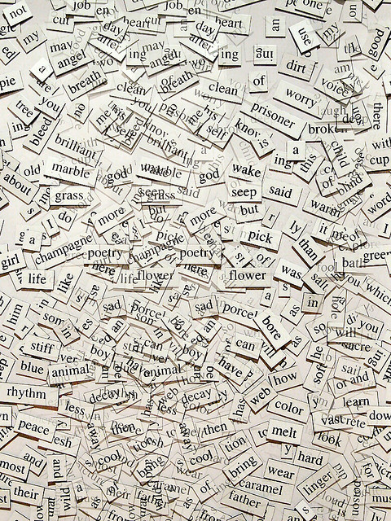

Counting (unique) words to evaluate diversity
Reads – sample A
K-mers – sample A
Reads – sample B
K-mers – sample B

Slide 23
Outline
Background and motivation
An efficient k-mer counting approach
Novel method to investigate microbial diversity
Concept of IGS (informative genomic segment)
Testing IGS method on simulated data sets
Testing IGS method on real metagenome data
Summary
An efficient k-mer counting approach

Slide 24
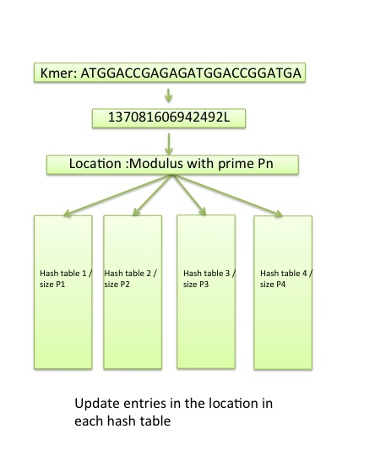
An efficient k-mer counting approach
The Count-min Sketch consists of one or more hash tables of different size
The hash function is to take the modulus of a number representing the k-mer with the table size.
Each entry in the hash tables is a counter representing the number of k-mers that hash to that location
To retrieve the count for a given k-mer we select the minimum count across all of the hash entries.
Highly scalable: Constant memory consuming, independent of k and dataset size
Probabilistic properties well suited to next generation sequencing datasets
With certain counting false positive rate as tradeoff because of collision
Notes:
To analysis based on unique k-mers , we need efifcietn k-emr countign method supopront fast online updating and retrieving. , we are dealing terybytes of data sets, all existing tols can not meet such requirement.
For this approach we usd a
then, to retrieve the count for a given k-mer we select the minimum count across all of the hash entries.
The advantage of this approach is highly scalable.

Slide 25
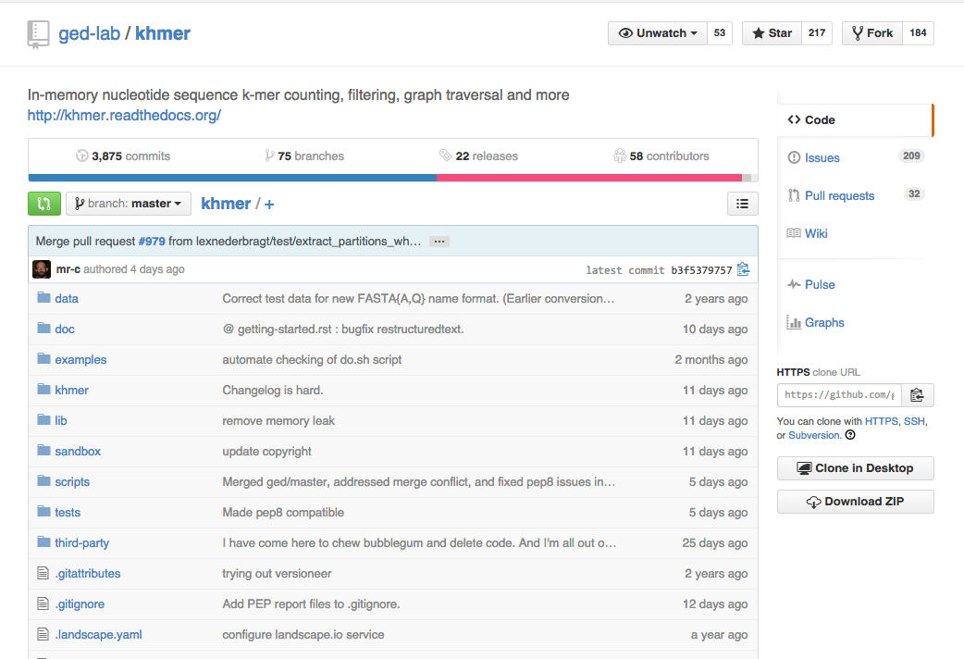
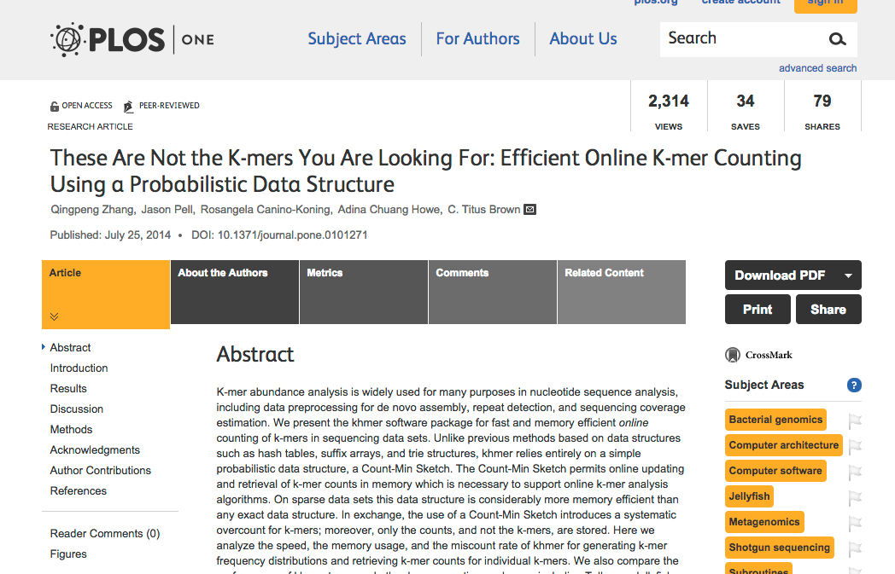
An efficient k-mer counting approach
My contributions:
algorithm design/analysis, exploring the mathematics behind, the choice of optimal parameters
contributing codes, including unique k-mers counting, overlap k-mer counting, optimal parameter choice, others related to my specific research project.
benchmarking, testing
exploration of applications like error trimming, filter low abundance reads, digital normalization, etc. suggestion on features
work on the khmer manuscript
Notes:
first time mention, khmer is a tool using data structure like bloom filter. to count, memory efficiently. it is scalarble, it can handle any size of data, just sacrificing accuracy.
later we not only use it to counkemrfor diversity , since khmer is a fundamental concept ignominy bioinfroamtion, in use of error correction, and assembly.
four years later, it is version1.1 now. and full time developer working on that. 34 contributors. more than 100 labs using it?
For this approach we usd a
then, to retrieve the count for a given k-mer we select the minimum count across all of the hash entries.
The advantage of this approach is highly scalable.
kmer saturation
longest developer, besides titus.
using it actually,
i didn’t write the most codes, titus is the one with ..
what i contributed basically are
the paper finally got accepted and published this summer. it is also 100 reproducible..
long time user,
developer actually
Data structure , not important
Skipped

Slide 26
Sequencing errors cause serious problem
>24288227
TTTGCCTGTTGAAAACCTGAAAACGGGATGTTTCCGGGGTTTTCCGCCCCGGTAGGGTTGAGACGTGCCCCGCGGTCGCGAACAGCTCGCCGCTTACCGGCGTAAGAGCGATCCGCAACACACCCCGGAGCCTCTACCCCCCCCTCACGC
c
In high coverage reads data set, most of the novel k-mers are erroneous caused by sequencing errors.
GAAAACCTGA
AAAACCTGAA
AAACCTGAAA
Notes:
It is difficult to perform any analysis with so many erroneous k-mers to count.

Slide 27
Outline
Background and motivation
An efficient k-mer counting approach
Novel method to investigate microbial diversity
Concept of IGS (informative
Testing IGS method on simulated data sets
Testing IGS method on real metagenome data
Summary
Concept of IGS (informative genomic segment)

Slide 28
A typical pipeline of metagenome diversity analysis
Sample1
Reads
Assembly
Contigs
Sequencing
1000+ bp
100-150 bp
Abundance
Species
Binning
3x
1x
1x
2x
Species A
Species B
Mapping
Species C
Species D
Species-by-sample table
Challenges:
Assembly? - difficult (eg. Only small portions of reads can be assembled)
Binning? – difficult (eg. may need reference genomes, computationally expensive)
Mapping? – difficult (eg. accuracy, computationally expensive)
4 petabase pairs of DNA in a gram of soil(Jack A. Gilbert,2013)
Notes:
We may nknow the definition of specis in mic is ambigous. It is diffuclty to distincgwaish, people have alreadsy used oTU to replace species as the unit for diversity, analysis. The otu taxonomy can represnet the 16 s rna reads that are similar with each other.

Slide 29
 | Sample1 | Sample2 | Sample3 | Sample4 | Sample5 | Sample6
SpeciesA | 3 | 3 | 4 | 4 | 0 | 0
SpeciesB | 1 | 3 | 0 | 2 | 2 | 2
SpeciesC | 1 | 2 | 2 | 2 | 3 | 3
SpeciesD | 2 | 1 | 2 | 1 | 1 | 1
SpeciesE | 4 | 1 | 3 | 0 | 2 | 5
SpeciesF | 5 | 1 | 2 | 2 | 2 | 5
SpeciesG | 2 | 2 | 1 | 2 | 1 | 3
 | S1 | S2 | S3 | S4 | S5 | S6
S1 | 0.0 | 0.25 | 0.5 | 0.5 | 0.75 | 1.0
S2 | 0.25 | 0.0 | 0.25 | 0.25 | 0.75 | 1.0
S3 | 0.5 | 0.25 | 0.0 | 0.25 | 0.75 | 1.0
S4 | 0.5 | 0.25 | 0.25 | 0.0 | 0.75 | 1.0
S5 | 0.75 | 0.75 | 0.75 | 0.75 | 0.0 | 0.25
S6 | 1.0 | 1.0 | 1.0 | 1.0 | 0.25 | 0.0
Alpha diversity: “How many different species in a seawater sample?”
Beta diversity: “How different are the seawater samples?”
Notes:
With this samples by species matrix, we can get similarity matrix between samples and do alpha diversity analysis or beta divesity to compare samples.

Slide 30
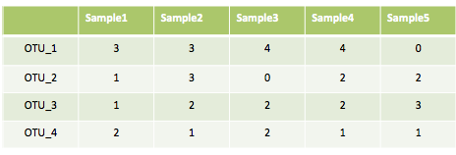
A typical pipeline of metagenome diversity analysis
Sample1
Reads
Assembly
Contigs
Sequencing
1000+ bp
100-150 bp
Abundance
Species
Binning
3x
1x
1x
2x
Species A
Species B
Mapping
Species C
Species D
Species-by-sample table
Challenges:
Assembly? - difficult (eg. Only small portions of reads can be assembled)
Binning? – difficult (eg. may need reference genomes, computationally expensive)
Mapping? – difficult (eg. accuracy, computationally expensive)
4 petabase pairs of DNA in a gram of soil(Jack A. Gilbert,2013)
Notes:
We may nknow the definition of specis in mic is ambigous. It is diffuclty to distincgwaish, people have alreadsy used oTU to replace species as the unit for diversity, analysis. The otu taxonomy can represnet the 16 s rna reads that are similar with each other.

Slide 31
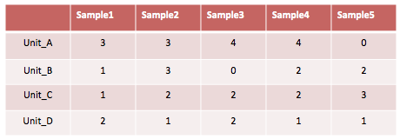
A typical pipeline of metagenome diversity analysis
Sample1
Reads
Assembly
Contigs
Sequencing
1000+ bp
100-150 bp
Abundance
Species
Binning
3x
1x
1x
2x
Species A
Species B
Mapping
Species C
Species D
Species-by-sample table
Challenges:
Assembly? - difficult (eg. Only small portions of reads can be assembled)
Binning? – difficult (eg. may need reference genomes, computationally expensive)
Mapping? – difficult (eg. accuracy, computationally expensive)
4 petabase pairs of DNA in a gram of soil(Jack A. Gilbert,2013)
Notes:
Ew want to find other unit that can be defined and the count can be aquried from wholge gnoem shto reads.
This wi where we need IGS.

Slide 32
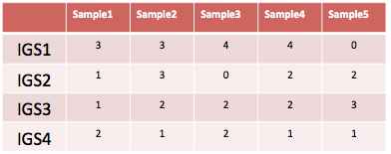
Replace samples-by-species table with samples-by-IGSs table
IGS (informative genomic segment)
can be used as a new unit to do diversity analysis to replace species/OTUs
can represent the novel information of a genome
Assembly-free
Reference-free
Efficient and scalable
Notes:
We can get the count of igs across samples from raw reads. It can be used.
It is can represent. The after after we get the table, there are a bunch of existing tools to do analysis downstream .
Next I will itnroduce how to get the table from if we only have the sequencing reads in diff samples.

Slide 33
From reads to IGSs
We can use median k-mer abundance to estimate the sequencing coverage of a read without a reference assembly.
We can retrieve the coverage of a read across different samples.
We can estimate the size of covered genomic region by the number of reads and the corresponding coverage.
Three tricks!
Notes:
Next I will talk about how to get the samples by IGS table and show you what Igs are actually.
In the procedure, we need three clever tricks that I will mention later.

Slide 34
Reads – sample A
K-mers – sample A
Coverage of a read and how to get it without a reference assembly
The abundance of the k-mers in a read tends to be similar, which is close to the sequencing depth of the DNA region that read originates from.
Notes:
Coverage of a read is the sequencing depth of the genomic segment this read covers. , how many reads cover this region.
Because the reads are scattered across the genome randomly. Here we are talking about average. And only works for large number of reads.
The abundance of the k-mers in a read tends to be similar, which is close to the sequencing depth of the DNA region that read originates from.
The more times a region is sequenced, the higher the abundance of k-mers from that region would be.

Slide 35
Reads – sample A
K-mers – sample A
>24288227
TTTGCCTGTTGAAAACCTGTAAACGGGATGTTTCCGGGGTTTTCCGCCCCGGTAGGGTTGAGACGTGCCCCGCGGTCGCGAACAGCTCGCCGCTTACCGGCGTAAGAGCGATCCGCAACACACCCCGGAGCCTCTACCCCCCCCTCACGC
TTTGCCTGTT
4
4
5
TTTCCGGGGT
5
TTGCCTGTTG
4
TTCCGGGGTT
5
4
TTCCGGGGTT
4
GAAAACCTGT
ATCCGCGGTT
4
5
TTCCGGGGTT
3
AAAACCTGTA
TTCCGGGGTT
4
TTCCGGCCGTT
5
AAACCTGTAA
4
GGTTTTTCCG

Slide 36
Reads – sample A
K-mers – sample A
x
x
>24288227
TTTGCCTGTTGAAAACCTGAAAACGGGATGTTTCCGGGGTTTTCCGCCCCGGTAGGGTTGAGACGTGCCCCGCGGTCGCGAACAGCTCGCCGCTTACCGGCGTAAGAGCGATCCGCAACACACCCCGGAGCCTCTACCCCCCCCTCACGC
TTTGCCTGTT
4
4
5
TTTCCGGGGT
5
TTGCCTGTTG
4
TTCCGGGGTT
5
1
TTCCGGGGTT
4
GAAAACCTGA
ATCCGCGGTT
4
1
TTCCGGGGTT
3
AAAACCTGAA
TTCCGGGGTT
4
TTCCGGCCGTT
5
AAACCTGAAA
1
GGTTTTTCCG

Slide 37
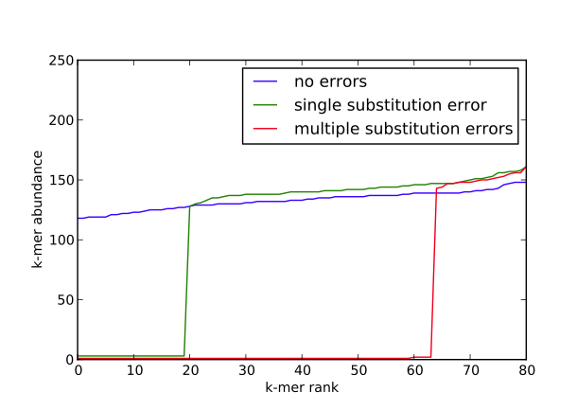
median k-mer abundance to represent the sequencing coverage of the read
>24288227
TTTGCCTGTTGAAAACCTGAAAACGGGATGTTTCCGGGGTTTTCCGCCCCGGTAGGGTTGAGACGTGCCCCGCGGTCGCGAACAGCTCGCCGCTTACCGGCGTAAGAGCGATCCGCAACACACCCCGGAGCCTCTACCCCCCCCTCACGC
TTTGCCTGTT
4
4
5
TTTCCGGGGT
5
TTGCCTGTTG
4
TTCCGGGGTT
5
1
TTCCGGGGTT
4
GAAAACCTGA
ATCCGCGGTT
4
1
TTCCGGGGTT
3
AAAACCTGAA
TTCCGGGGTT
4
TTCCGGCCGTT
5
AAACCTGAAA
1
GGTTTTTCCG
Notes:
Next, based on k-mer counting, we devekp a mehtod to estimate the sequencing coverage of a read
If there is no error, the more time a sgemtn of dna is sequenced, the thighe abundance of k-mers from the reads would be after we count all the k-mer sin the sequencing data set, fi no erorr,
Sequencing coverage of a read ,a s segment of dna of a species precisely, estmiate by the k-mers abundanc,e
But hter eeror, one error can bgenerate a lot fo eror k-mers, decrease the abundance, of those k-mers.
But if we use median instead average,
The influence can be eliminated, if k small, leng th logner.
Only multiple erors ppere inlfunec,
Figure, we get the abundacne of k-emr sin read, and rank them , get the median , median will be the true of sequncing coverage
Using median k-mer frequency rather than
average k-mer frequency can decrease the influence
of sequencing error

Slide 38
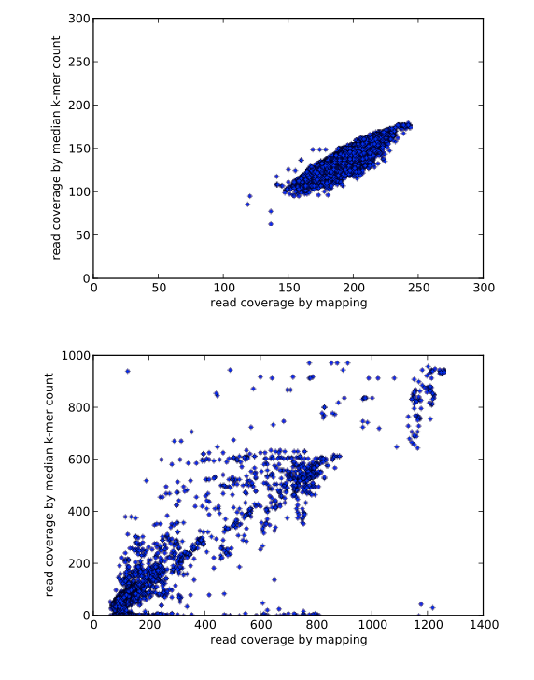
median k-mer abundance to represent the sequencing coverage of the read
Trick 1: We can use median k-mer abundance to estimate the sequencing coverage of a read without a reference assembly.
Notes:
Next, based on k-mer counting, we devekp a mehtod to estimate the sequencing coverage of a read
If there is no error, the more time a sgemtn of dna is sequenced, the thighe abundance of k-mers from the reads would be after we count all the k-mer sin the sequencing data set, fi no erorr,
Sequencing coverage of a read ,a s segment of dna of a species precisely, estmiate by the k-mers abundanc,e
But hter eeror, one error can bgenerate a lot fo eror k-mers, decrease the abundance, of those k-mers.
But if we use median instead average,
The influence can be eliminated, if k small, leng th logner.
Only multiple erors ppere inlfunec,
Figure, we get the abundacne of k-emr sin read, and rank them , get the median , median will be the true of sequncing coverage
Using median k-mer frequency rather than
average k-mer frequency can decrease the influence
of sequencing error

Slide 39
Reads – sample A
K-mers – sample B
Trick 2: We can estimate the sequencing coverage of a read across different samples

Slide 40
Sample A
Coverage = 4
Read Coverage Profile:
Sample B
A:B:C
=
4:6:2
Coverage = 6
Sample C
Coverage = 2
Notes:
The same, another ,reads,

Slide 41
3:2:2
2:4:3
2:0:3
Sample A
3:2:2
3:2:2
2:0:3
2:0:3
3:2:2
3:2:2
3:2:2
2:4:3
2:0:3
Sample B
3:2:2
2:4:3
2:4:3
3:2:2
2:4:3
3:2:2
2:4:3
3:2:2
3:2:2
Sample C
2:0:3
2:4:3
2:4:3
2:0:3
2:0:3
3:2:2
3:2:2
2:0:3
2:0:3
2:4:3
2:0:3
3:2:2
Notes:
So we can get all the coverage profiles of all the reads in sample.s
I nned to quote a notion here, contigs. With ,
Siilarl , reads the same,
We group reads together with same profiles. They are likely be the observations of the same genomic regions.

Slide 42
3:2:2
2:4:3
2:0:3
Sample A
3:2:2
3:2:2
2:0:3
2:0:3
3:2:2
3:2:2
3:2:2
2:4:3
2:0:3
“Contigs with similar coverage profiles are likely to have originated from the same microbial population” (Imelfort et al. 2014)
Reads with similar coverage profiles are likely to have originated from the same species.
Sample B
3:2:2
2:4:3
2:4:3
3:2:2
2:4:3
3:2:2
2:4:3
3:2:2
3:2:2
Sample C
2:0:3
2:4:3
2:4:3
2:0:3
2:0:3
3:2:2
3:2:2
2:0:3
2:0:3
2:4:3
2:0:3
3:2:2
Notes:
So we can get all the coverage profiles of all the reads in sample.s
I nned to quote a notion here, contigs. With ,
Siilarl , reads the same,
We group reads together with same profiles. They are likely be the observations of the same genomic regions.

Slide 43
3:2:2
2:4:3
2:0:3
3:2:2
3:2:2
2:0:3
2:0:3
3:2:2
3:2:2
3:2:2
2:4:3
2:0:3
Genomic Content Sample A
3:2:2
2:4:3
2:4:3
3:2:2
2:4:3
3:2:2
2:4:3
3:2:2
Do the reads in each bin cover the same size of genomic region?
6 reads with coverage of 3 in the sample where they are from
Genomic Content Sample B
3:2:2
VS
2:0:3
2:4:3
2:4:3
2:0:3
2:0:3
2 reads with coverage of 2 in the sample where they are from
3:2:2
3:2:2
2:0:3
2:4:3
Super bin 1
2:0:3
Super bin 2
Super bin 3
2:0:3
3:2:2
Genomic Content Sample C
Notes:
“Super bin” , we can not say we splti into species. Into genomic regions. Are covered by group reads.
Next we want to ask. Do the the same szie?? Actuall not. Let’s look at this. Twice as large as the region this two reads cover.
The unit will be IGSs.
Do they cover the same size of segment on the genome? No.

Slide 44
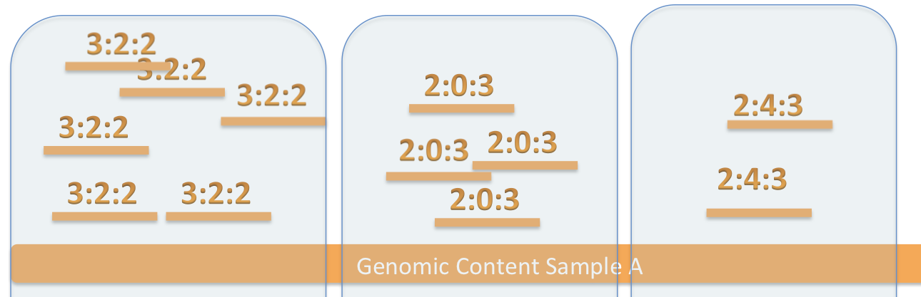
Do the reads in each bin cover the same size of genomic region?
6 reads with coverage of 3 in the sample where they are from
VS
2 reads with coverage of 2 in the sample where they are from

Slide 45
Reads – sample A
K-mers – sample A
Trick 3pre: If a read has a coverage as C, there will be approximately other C-1 reads with the same coverage (covering the same DNA region).

Slide 46
Reads – sample A
Trick 3: We can estimate the size of covered genomic region by the number of reads(N) and the corresponding coverage(C).

Slide 47
Reads – sample A
N ~= 30, C ~= 10
N ~= 7, C ~= 7
Trick 3: We can estimate the size of covered genomic region by the number of reads(N) and the corresponding coverage(C).

Slide 48
Reads – sample A
Size of covered DNA region
N ~= 30, C ~= 10
N ~= 7, C ~= 7
Trick 3: We can estimate the size of covered genomic region by the number of reads(N) and the corresponding coverage(C).

Slide 49
Reads – sample A
Size of covered DNA region
N ~= 30, C ~= 10
N ~= 7, C ~= 7
Unit of estimated size: IGS - IGS(informative genomic segment)
Trick 3: We can estimate the size of covered genomic region by the number of reads(N) and the corresponding coverage(C).

Slide 50
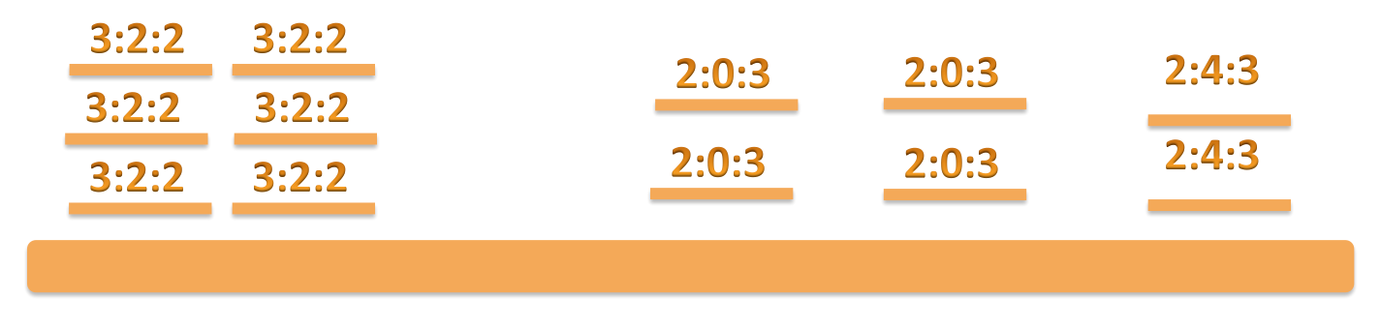
Do the reads in each bin cover the same size of genomic region?
6 reads with coverage of 3 in the sample where they are from
VS
2 reads with coverage of 2 in the sample where they are from
6/3 = 2
4/2 = 2
2/2 = 1

Slide 51
3:2:2
3:2:2
2:0:3
2:0:3
2:4:3
3:2:2
3:2:2
2:0:3
2:0:3
2:4:3
3:2:2
3:2:2
 | SampleA | SampleB | SampleC
IGS1 | 3 | 2 | 2
IGS2 | 3 | 2 | 2
IGS3 | 2 | 0 | 3
IGS4 | 2 | 0 | 3
IGS5 | 2 | 4 | 3
2:4:3
3:2:2
3:2:2
2:4:3
3:2:2
3:2:2
2:4:3
2:4:3
3:2:2
3:2:2
2:4:3
2:0:3
2:0:3
3:2:2
3:2:2
2:0:3
2:0:3
2:4:3
2:0:3
2:0:3
2:4:3
Notes:
With this diferent igs and the coerage, observeance, it is easy to have sample by igs matirx like this.
If they are have similar coverage profile,
Get the number of segments.
How many stuffs
Cover more stuffs than this one, twice as large as smaller one

Slide 52
A typical pipeline of metagenome diversity analysis
Sample1
Reads
Assembly
Contigs
Sequencing
1000+ bp
100-150 bp
Abundance
Species
Binning
3x
1x
1x
2x
Species A
Species B
Mapping
Species C
Species D
Species-by-sample table
Challenges:
Assembly? - difficult (eg. Only small portions of reads can be assembled)
Binning? – difficult (eg. may need reference genomes, computationally expensive)
Mapping? – difficult (eg. accuracy, computationally expensive)
4 petabase pairs of DNA in a gram of soil(Jack A. Gilbert,2013)
Notes:
Now we have igs and we find the short cut, and do diversity anslsyis.

Slide 53
IGS(informative genomic segment) can represent the novel information of a genome
IGS (informative genomic segment)
The more IGSs there are in a sample, the higher diversity , higher richness the sample has.
The more IGSs two samples share, the more similar the two samples are.

Slide 54
Outline
Background and motivation
An efficient k-mer counting approach
Novel method to investigate microbial diversity
Concept of IGS (informative genomic segment)
Testing IGS method on simulated data sets
Testing IGS method on real metagenome data
Summary
Testing IGS method on simulated data sets

Slide 55
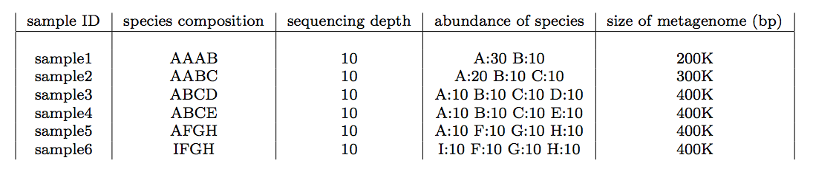
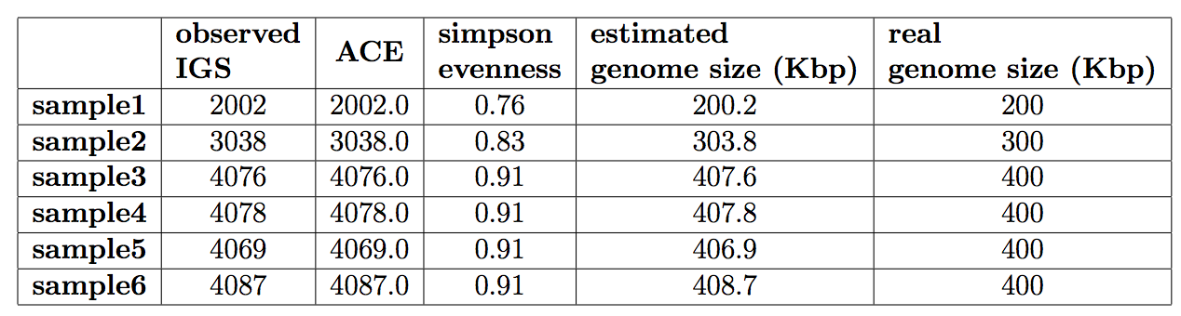
Simulated data sets with different species composition
No sequencing error is introduced in this simulated data
Estimated genome size matches real size perfectly.
Notes:
Let’s see how it works in real world.
Firstly check the simiulated datadst.
6
Got igs and

Slide 56
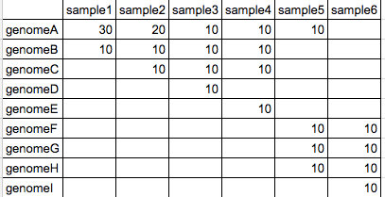
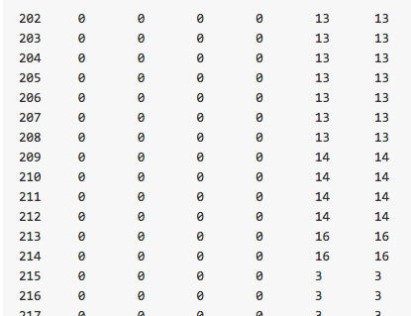
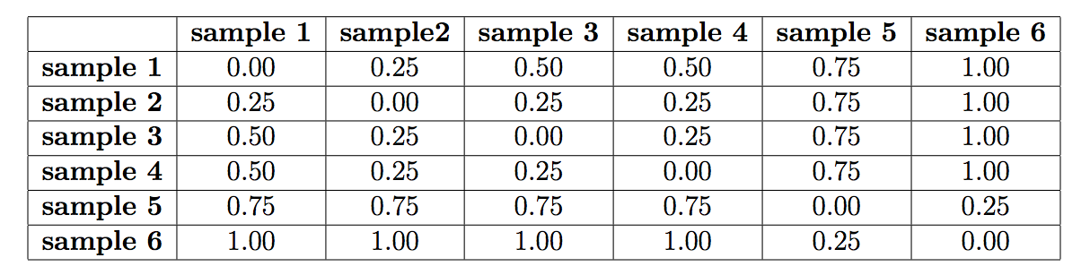
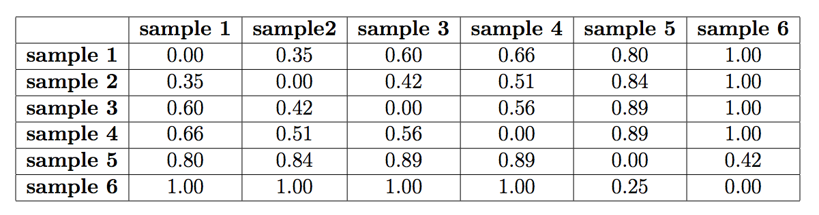
Samples-by-species matrix
Samples-by-IGSs matrix
Ground truth
^{Mantel Correlation:}
^{0.9714}
Using IGS method
Calculated dissimilarity matrix matches the matrix calculated from species composition.

Slide 57

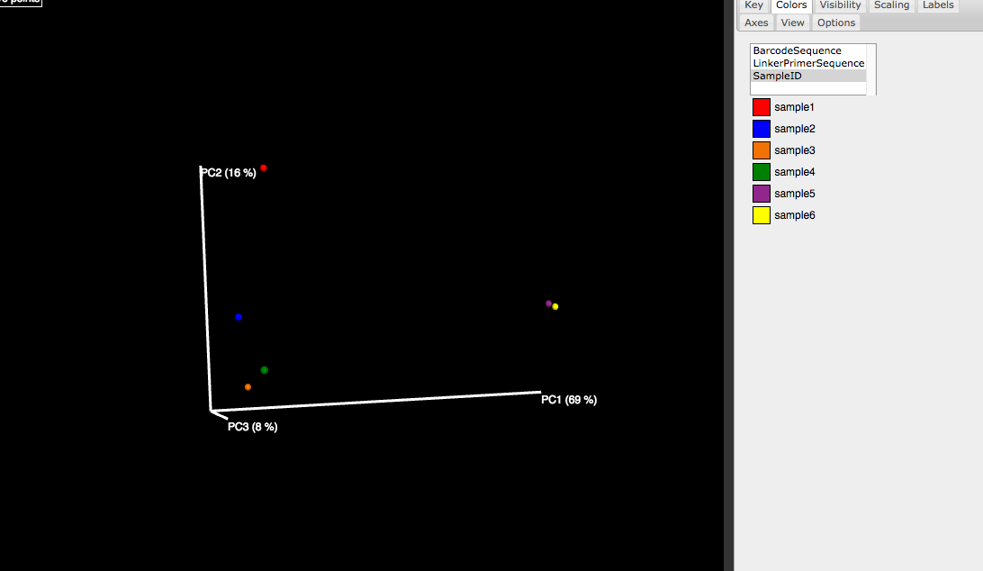
With an accurate dissimilarity matrix, it will be straightforward to perform PCoA or clustering analysis to demonstrate the relationship between samples.
Ordination (PCoA)
Clustering
AFGH
FGHI
ABCE
AABC
ABCD
AAAB

Slide 58
Influence of error rate and coverage to accuracy
Metagenome size is more accurate with increasing coverage and lower error rate
Beta diversity is less prone to error rate and low coverage

Slide 59
Outline
Background and motivation
An efficient k-mer counting approach
Novel method to investigate microbial diversity
Concept of IGS (informative genomic segment)
Testing IGS method on simulated data sets
Testing IGS method on real metagenome data
Summary
Testing IGS method on real metagenome data

Slide 60
Sorcerer II Global Ocean Sampling Expedition
Notes:
Reasl data et, the sea water got sampled in diffenrelnt locations. Got sequenced. Got ther eaed with
Using igs methods.

Slide 61


Samples can be separated by locations using IGS-based method – as good as the result in original research based on alignment-based method or better.
Tropical and Sargasso
Tropical - Galapogas
Tropical – Open Ocean
Sargasso
Temperate
Temperate - North
Temperate - South
Estuary

Slide 62
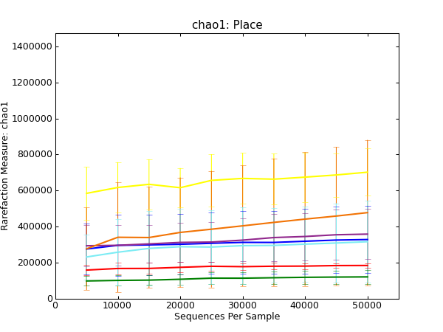
Alpha diversity analysis shows samples from tropical area have higher richness.
Sargasso
Tropical and Sargasso
Tropical - Open Ocean
Tropical - Galapogas
Temperate -South
Estuary
Temperate
Temperate - North

Slide 63
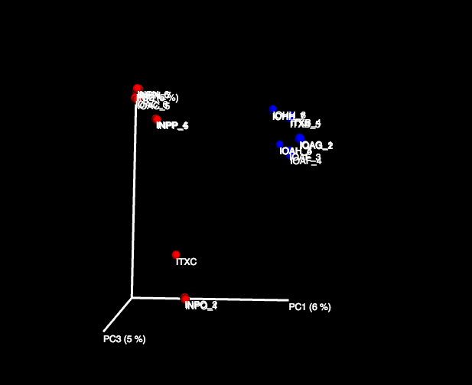
Some soil samples – ARMO (1m reads subset)
Blue: Prairie
Red: Forest
Samples can be separated by different treatments using IGS method.

Slide 64
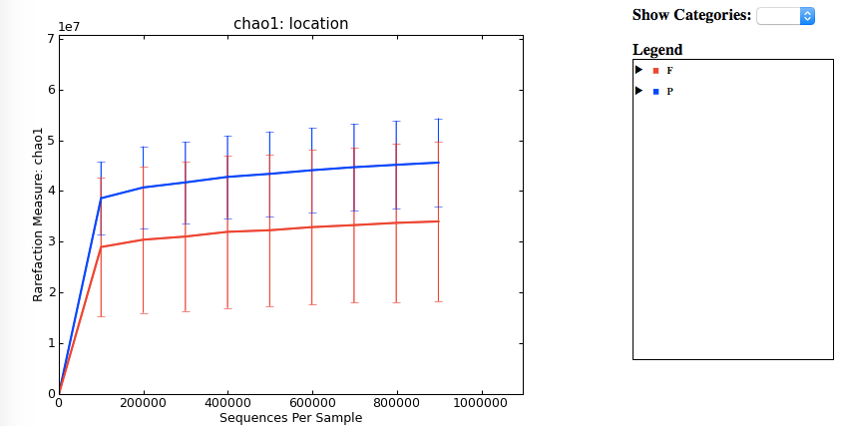
Alpha diversity analysis shows samples from prairie area have higher richness than forest area.

Slide 65
Some soil samples – ARMO (larger subsample)
Blue: Prairie
Red: Forest

Slide 66
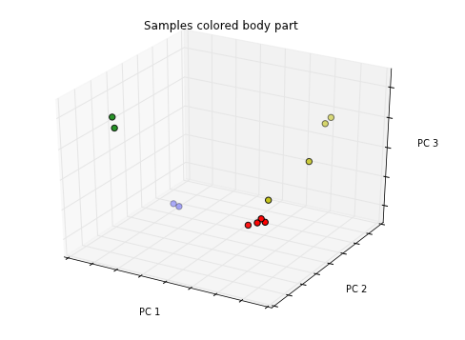
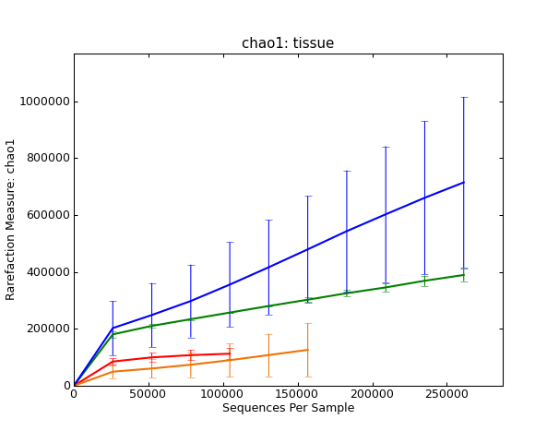
Bonus: HMP (Human Microbiome Project)
12 samples from ~700 HMP samples with 3 groups from different body parts (skin, oral, vaginal)
- red: anterior nares - skin
- green: throat - oral
- blue: buccal_mucosa - oral
- yellow: posterior fornix - vaginal
Samples can be separated by locations using IGS method.
Oral samples have higher richness than samples from other body parts.

Slide 67
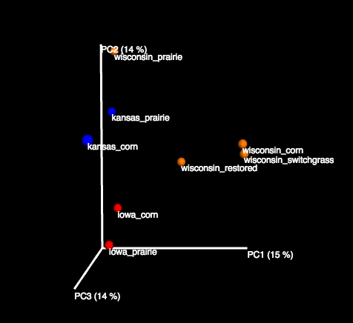
Bonus: Some soil samples – GPGC data (1m reads subset)
Samples can be separated by locations using IGS method.

Slide 68
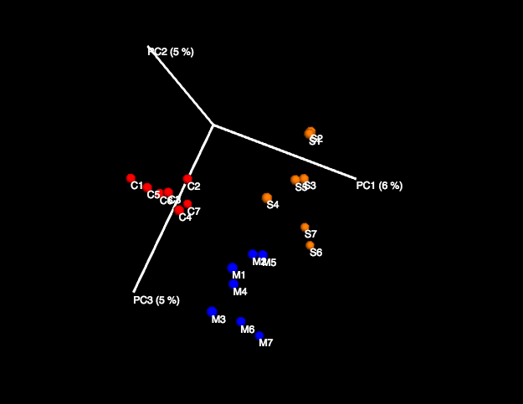
Bonus: Some soil samples – KBS samples(1m reads subset)
C :corn
S : switchgrass
M : miscanthus
Samples can be separated by different treatments using IGS method.

Slide 69
Outline
Background and motivation
An efficient k-mer counting approach
Novel method to investigate microbial diversity
Concept of IGS (informative genomic segment)
Testing IGS method on simulated data sets
Testing IGS method on real metagenome data
Summary
Summary

Slide 70
Summary
A whole framework with potentials:
Alpha diversity ( richness, evenness) (Chao1, ACE estimators, etc.)
Beta diversity ( abundance-based, incidence-based)
Scalable, efficient:
Based on efficient k-mer counting
Using subsamples may be enough for specific task

Slide 71
What’s next
Extend applications beyond diversity analysis
Extracts interesting reads by coverage profile
Reads binning/classification based on reads coverage profile
Genome size estimation/sequencing effort evaluation
co-assembly
Refine pipeline, optimize performance
Adjust IGS resolution
Improve method to deal with large number of IGSs more efficiently
Iterative beta diversity analysis

Slide 72
Publications
IGS method
Using the concept of informative genomic segment to investigate microbial diversity of metagenomic sample (in preparation)
[stream Crossing the streams: a framework for streaming analysis of short DNA sequencing reads. Qingpeng Zhang, Sharon Awad, C. Titus Brown. (submitted) https://peerj.com/preprints/890/
[khmer] These are not the k-mers you are looking for: efficient online k-mer counting using a probabilistic data structure. Qingpeng Zhang, Jason Pell, Rosangela Canino-Koning, Adina Chuang Howe, C. Titus Brown. PLOS ONE, July 25, 2014, DOI: 10.1371/journal.pone.0101271 http://journals.plos.org/plosone/article?id=10.1371/journal.pone.0101271
[diginorm] A Reference-Free Algorithm for Computational Normalization of Shotgun Sequencing Data. C. Titus Brown, Adina Howe, Qingpeng Zhang, Alexis B. Pyrkosz, Timothy H. Brom. Submitted. http://arxiv.org/abs/1203.4802
[Osedax] Genomic versatility and functional variation between two dominant heterotrophic symbionts of deep-sea Osedax worms. Shana K Goffredi, Hana Yi, Qingpeng Zhang, Jane E Klann,Isabelle A Struve, Robert C Vrijenhoek and C Titus Brown. The ISME Journal doi:10.1038/ismej.2013.201
error analysis
khmer
digital normalization
seaworm symbiont
Notes:
Besides， kmer counting approache and Igs based diversity analysis approach, I have also worked some other projects, they are all related to diversity analysis in some way.

Slide 73
Acknowledgement
Committee members
Jaimes Cole
Richard Enbody
Yanni Sun
Eric Torng
Former members of GED
Dr. Adina Howe
Eric McDonald
Dr. Jason Pell
Dr. Likit Preeyanon
Dr. Elijah Lowe
khmer developers
Dr. Titus Brown
Lab members of GED
Dr. Sherine Awad
Michael Crusoe
Jiarong Guo
Luiz Irber
Camille Scott
Collaborators
Dr. James Tiedje
Dr. Joan Ross
Dr. Shana K Goffredi
Yiseul KIm
Funding agency:

